Slide 1
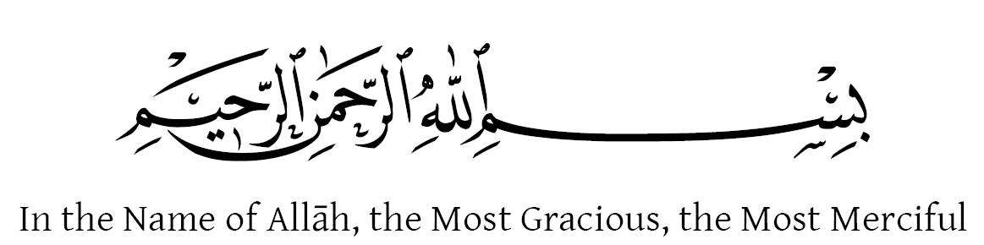


Slide 2

Mehria Marquee System
Supervised by:
Mr. Muhammad Kamran
Group Members:
Ahsan Ali (SP17-BSE-001)
Muhammad Muzammil (SP17-BSE-025)
Presented on 10 December 2020
Department of Computer Science
COMSATS University Islamabad
Attock Campus

Slide 3
Outline
_______________________________
Introduction
Related Work / Applications
Problem statement
Objectives
Methodology
System Architecture
Requirement Analysis
System Flow Process
Design Model
Modern tools
Benefits
System Interfaces
Conclusion
Future work
References
_______________________________

Slide 4

Introduction
The main hit that leads the way to develop the system was to overcome the difficulties and the flaws faced by marquees administration in managing their core business entities that includes reservation, stocks and accounts.
Improper and unformal way of reserving, high percentage of calculations in business accounts and poor managing of stock makes a way to develop a system that manages all these for marquee administration.

Slide 5
Continued...
Mehria Marquee System is a customized web application developed for managing the intra-business activities of the entities. These entities include;
Reservation
Stock
Accounts

Slide 6
Continued...
Reservation is a portal that provides the user with the facility of feeding all required information to the server by asking him/her to provide personal information like booking date, name of customer etc.
Stock is a portal that provides the user with facility to keep records of each item like meat, vegetables, grocery etc. Record includes price, quantity, category and date of inclusion in stock etc.

Slide 7
Continued...
Accounts department deals with the cash flow of the business. It not only manages it but also allocates monetary resources where required, maintains check and balance, calculates gross profit & loss, sales etc.
System will use cloud storage as a backup and syncs the files to it.

Slide 8
Related Work / Applications
There are a lot of projects in the market that exhibits the same basic functionalities as ours have but the main difference in ours is, the modules are designed specifically to fulfill the requirements of the customer. Some of the related work is shown below,
Marriage Hall Management Islamabad; Exhibits the functionality of Customer Information management, Calendar management, Order Booking management etc. [1]

Slide 9
Problem Statement
At present, the customers are facing serious problems in managing and keeping track of all the entities that are implemented by individuals as they have to record the data manually on receipt books.
Moreover, data about these entities is stored separately as manual receipt books.
Another problem is if the users require to generate reports about previous month’s sales (profit/loss/expenses), balance sheet and income statement etc. The users have to troll through the details of cash-flow and thus do extensive and cautious calculations.

Slide 10
Objectives
The system will provide,
The complete cash flow statement.
The marquee’s current assets info, liabilities, and stockholder’s equity.
To keep record of events , customers, stock used in specific events and stock quantity update history.
The profit and loss report, ledger and income tax report date wise.

Slide 11
Objectives(Continue…)
The summary of financial status at the end of a month.
The opportunity to develop technical skills and provide knowledge regarding this domain.

Slide 12
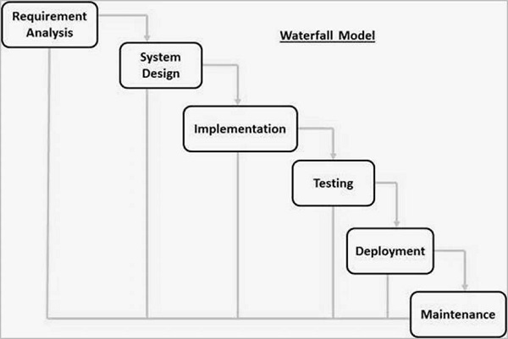
Methodology
We used waterfall model for SDLC.

Slide 13
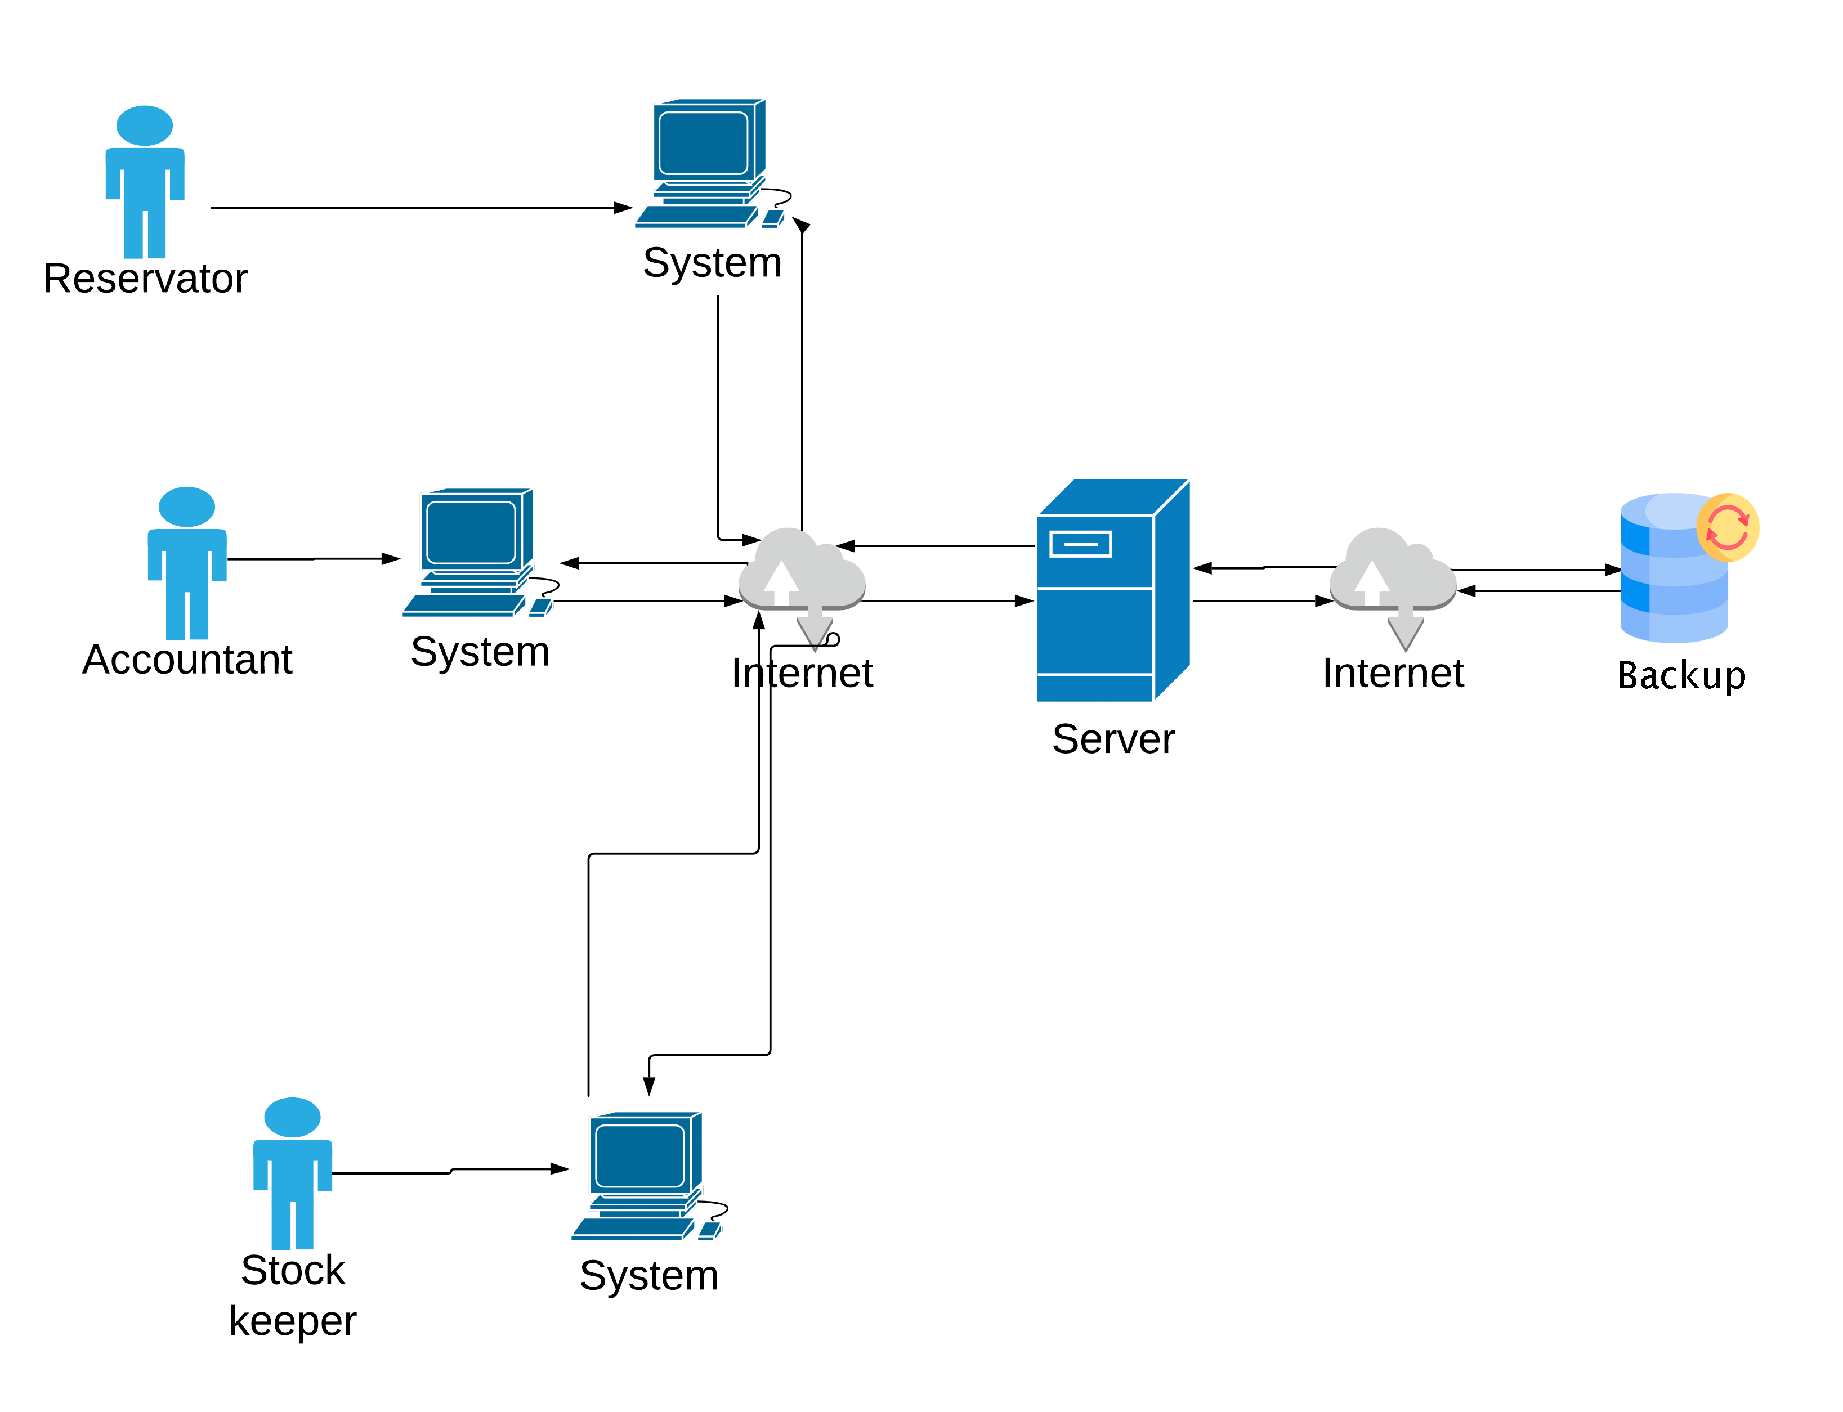
System Architecture

Slide 14
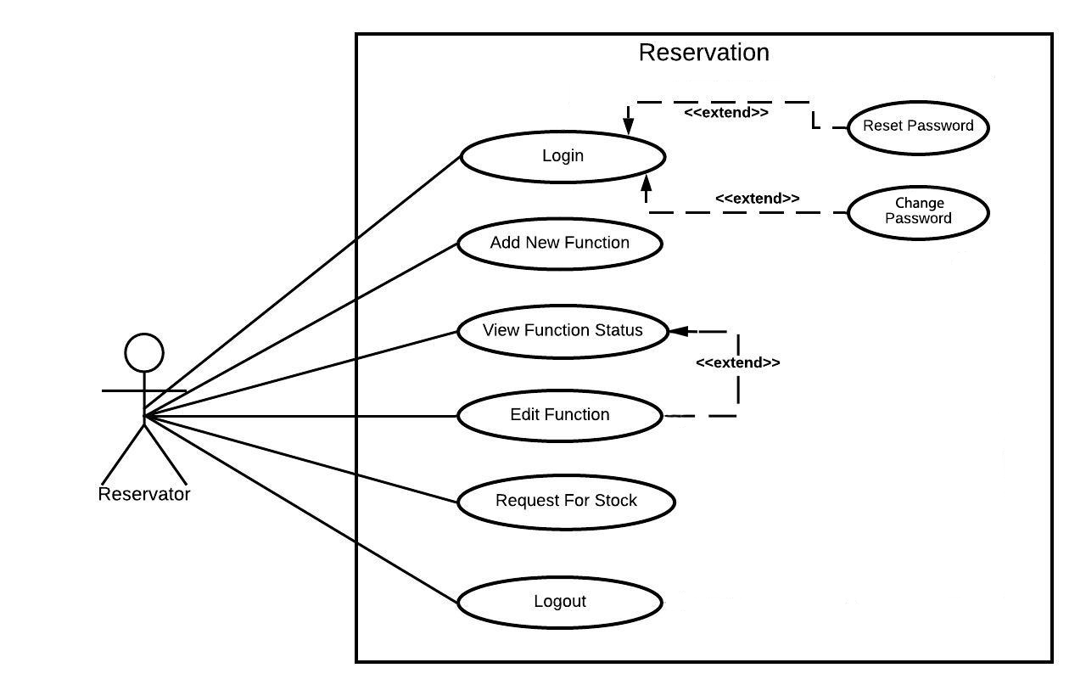
Requirement Analysis
Reservator Use Case

Slide 15
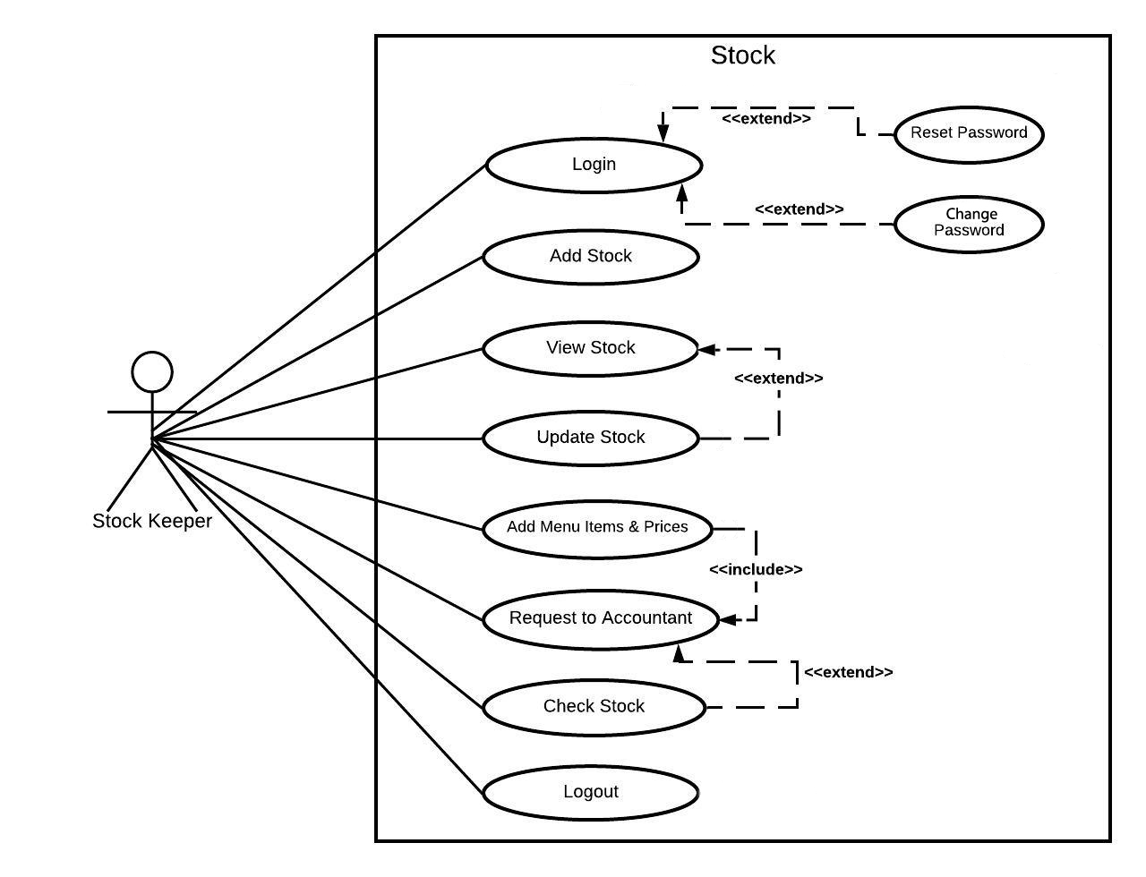
Requirement Analysis(1)
Stock keeper Use Case

Slide 16
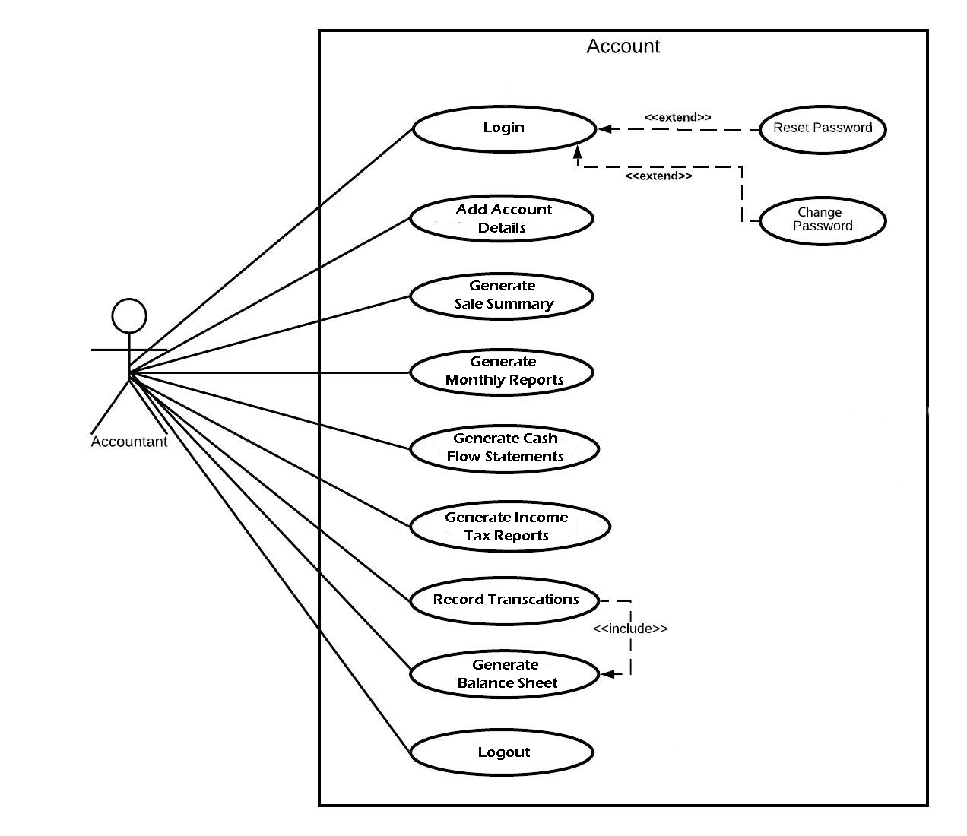
Requirement Analysis(2)
Accountant Use Case

Slide 17
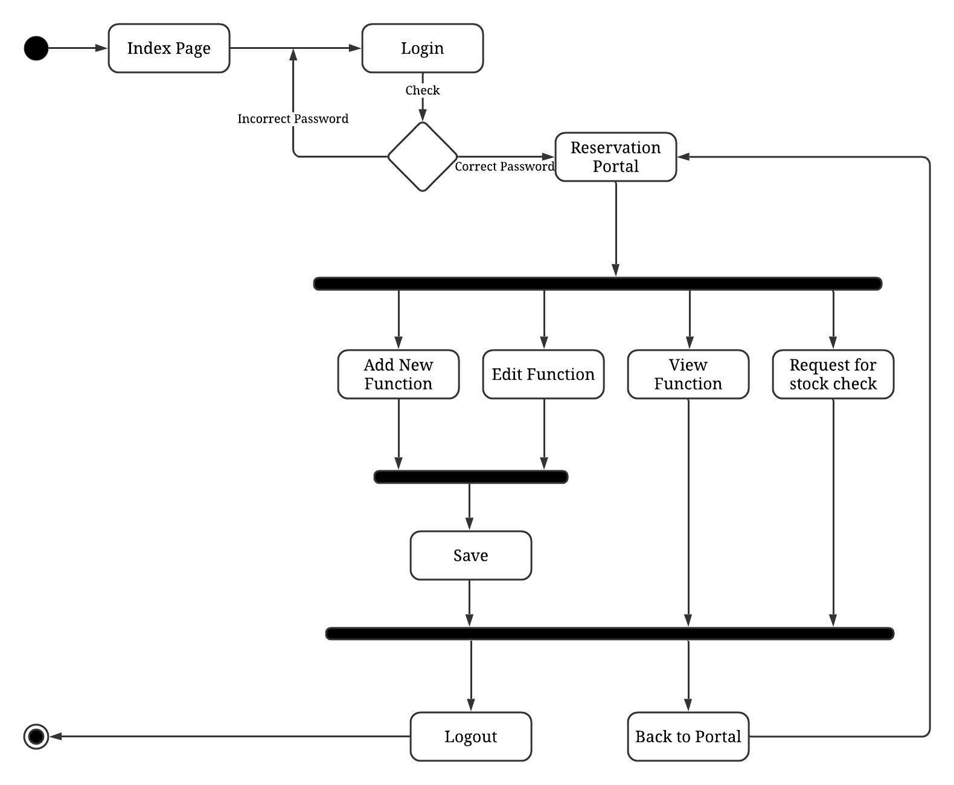
System Flow Process
Reservation Process Flow

Slide 18
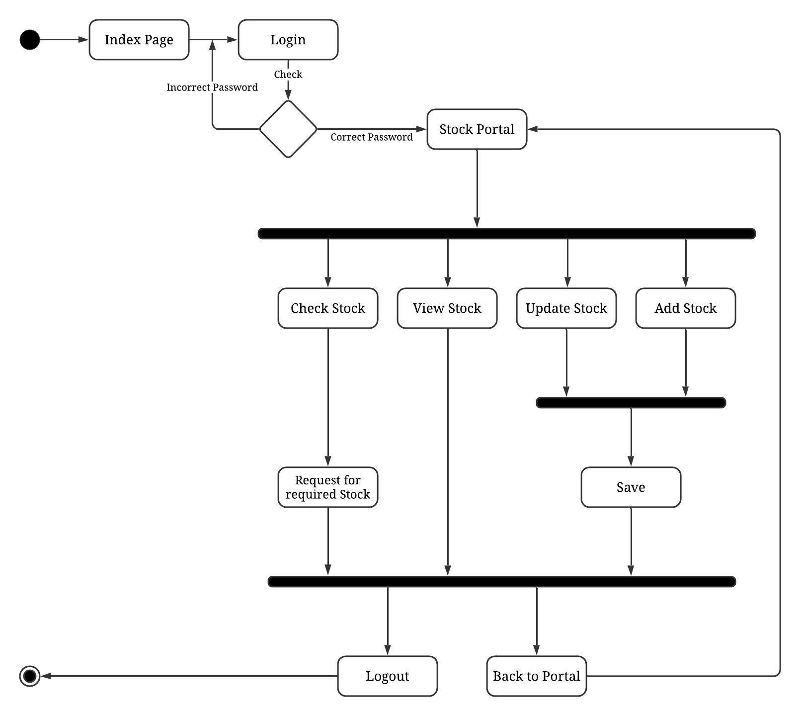
System Flow Process(1)
Stock Process Flow

Slide 19
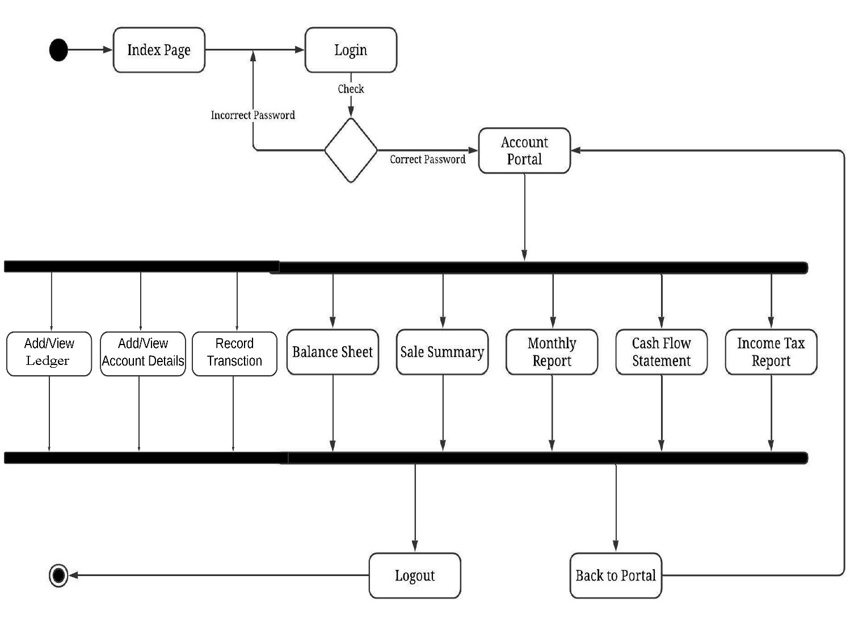
System Flow Process(2)
Account Process Flow

Slide 20
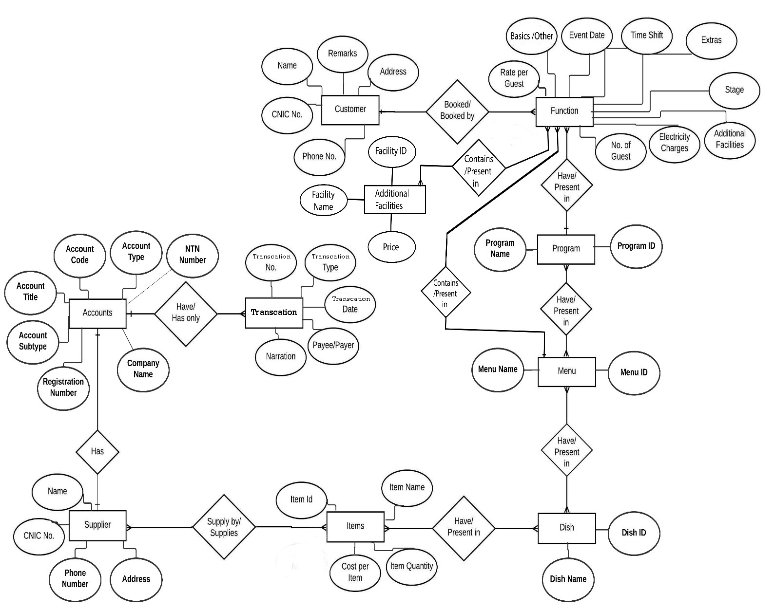
Design Model
Entity Relationship Diagram

Slide 21
Tools & Technologies
Tools | Version | Rational
SQL Server Database | 19c | DBMS
Visual Studio | 2017 | ASP.Net MVC 5 for development
Plesk | 18.0.31 | For hosting website
MS Visio | 2016 | For UML Diagrams
Bootstrap | 3.0 | CSS Styling
CSharp (C#) |  | Programming Language
SQL |  | Query Language

Slide 22
HosterPk (Plesk Hosting)
This web application is hosted on external hosting service named as HosterPk.
Plesk control panel provides the GUI interface of hosting server to deploy and maintain the website.

Slide 23
Benefits
Minimizing complexity of the whole business and reduce the possibilities of human errors.
It will also help stakeholders of the business to overwatch the business cashflow.
It will ultimately help the users to remain updated with each entity.
Every report will be generated by the system automatically based on account’s calculations.

Slide 24
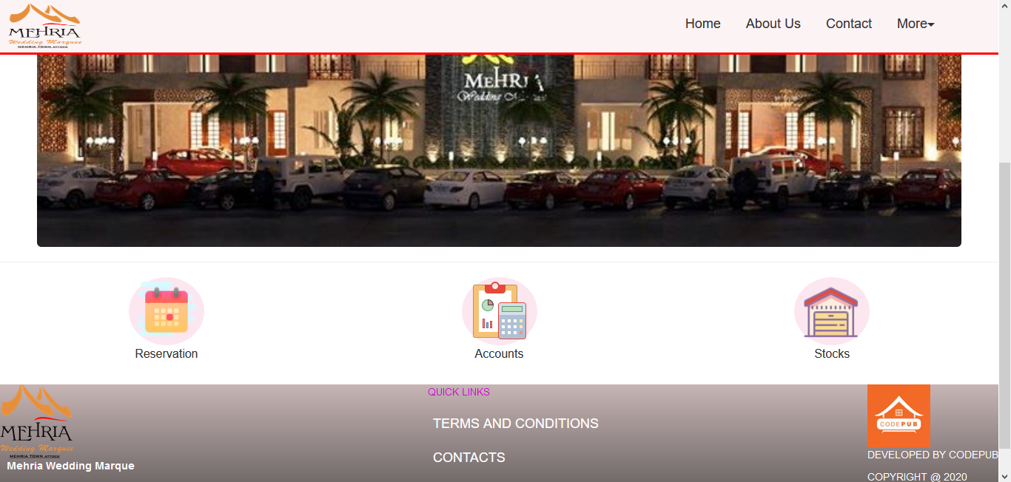
Main Page Interface

Slide 25
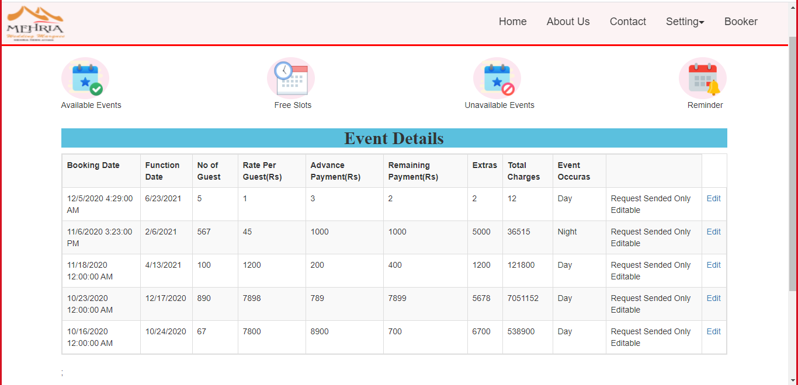
Reservation Portal Dashboard

Slide 26
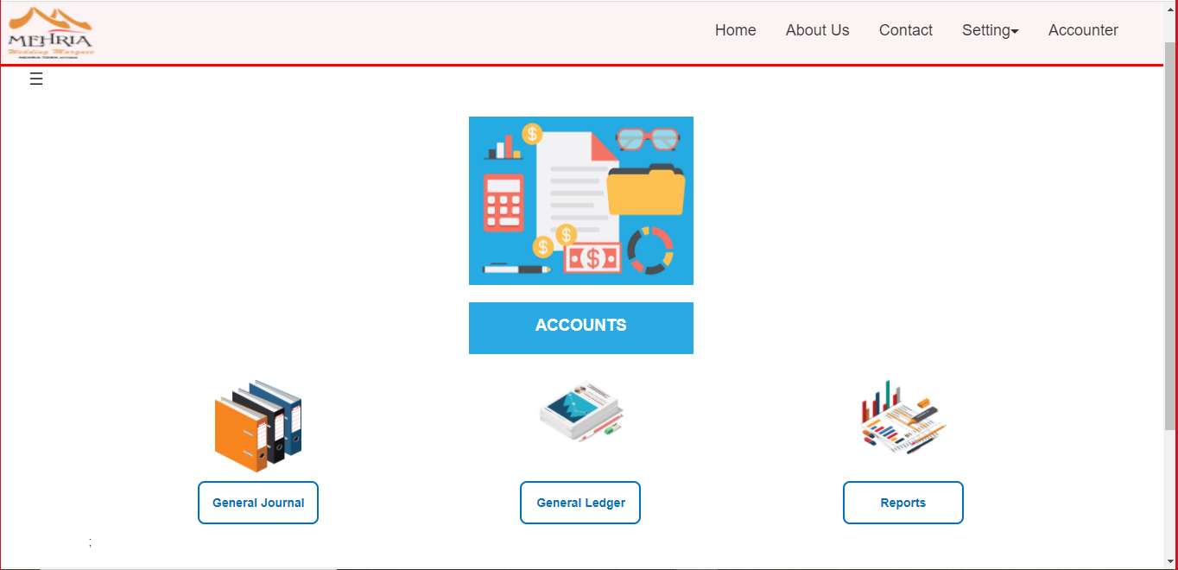
Account Portal Dashboard

Slide 27
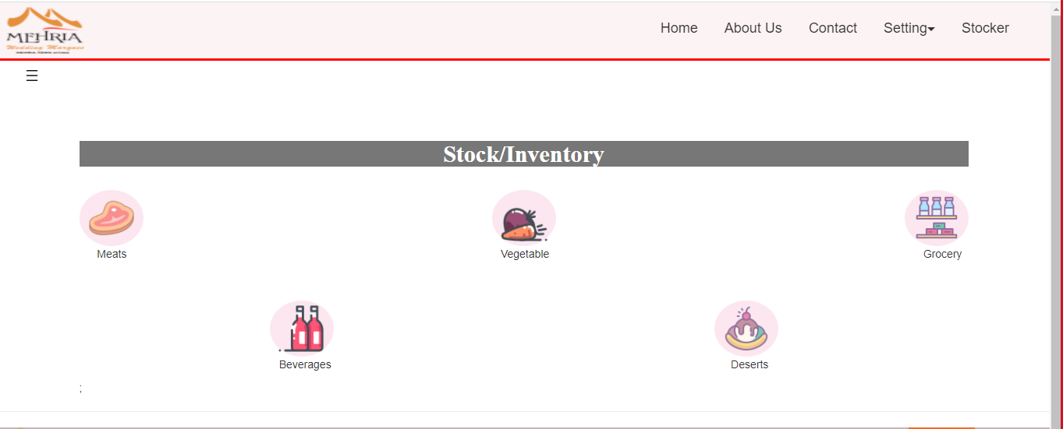
Stock Portal Dashboard

Slide 28
Conclusion
Mehria Marquee Administration is full fledge application for business purpose. This application saves a lot of time and cost of the user. As we have used advance framework to develop this application. This application handles their reservation, stock and account information in an efficient way. And we are familiar with the MVC framework to develop websites projects.

Slide 29
Future Work
We will give continuously support and maintenance that will bring new functionalities in the application.
We will out-source this application for other marquee’s with new features and more customization.
We would add the feature of adding dynamic menu out of given dishes.

Slide 30
References
[1] S. P. Inc.. [Online]. Available: https://www.solutionsplayer.com/marriage-hall-management/.

Slide 31


